Slide 1
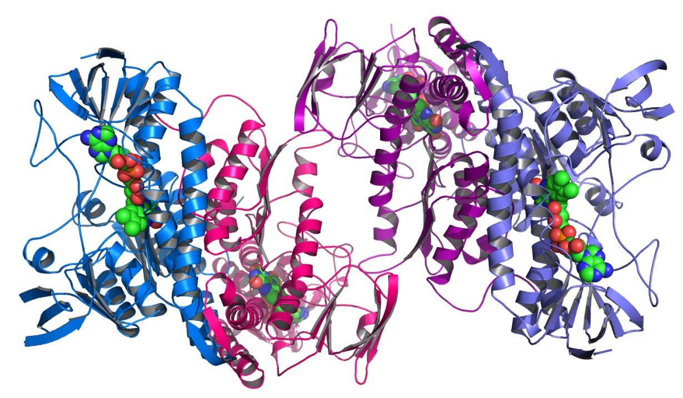
BIOL 8700: Experimental Plans Part 1
Terry Neeman, PhD AStat
Biology Data Science Institute (BDSI)
Joint Colleges of Science, ANU

Slide 2
What a first course in statistics emphasises….

Slide 3
What statistics is really about:
Notes:
VARIATION: talk about sources of variation

Slide 4
The centrepiece of statistics:
Models, not p-values
Model: a descriptive summary of the data
Model: telling the “big picture” story of the data
Model: an explanatory summary of the data
Model: a mechanism for predicting outcomes
Model: turning data into information.

Slide 5
Model of an Experiment
Outcome
Experimental factors
Nuisance factors (Blocking)
Unexplained variation

Slide 6
When you just think about doing some statistical test, you may forget about other important sources of variation….

Slide 7
What is effect of LPS challenge on sexually selected traits in guppies?
Tank 1: control guppies
Tank 2: LPS-injected guppies

Slide 8
Compare mean sperm velocity pre- and post-
Pre
Post
LPS control
LPS control

Slide 9
Outcome
Experimental factors
Nuisance factors (Blocking)
Unexplained variation
Questions
Nuisance factors:
Are the differences observed due to Treatment or Tank?
Could the differences observed be due to differences in fish size between groups?
What are the potential nuisance factors in this experiment?

Slide 10
Outcome
Experimental factors
Nuisance factors (Blocking)
Unexplained variation
More Questions
Experimental factors:
Does LPS injection impact response?
Does the LPS effect different post vs pre?
Is there an overall time effect (post vs pre)?
How can we ensure that the LPS effect is not confounded with the nuisance factors?

Slide 11
Model-centered thinking
Principles of Experimental Design

Slide 12
KEY PRINCIPLES in Experimental Design and Analysis
CONTROLS
REPLICATION
BLOCKING
RANDOMISATION
BLINDING
Notes:
This is not a really old subject. Goes back about 90 years to agricultural experiments in the 1920s and 30s.

Slide 13
KEY PRINCIPLES in Experimental Design and Analysis
CONTROLS:
Direct comparison with a known standard or no treatment.
Tested under identical conditions to experimental treatment.
REPLICATION
BLOCKING
RANDOMISATION
BLINDING

Slide 14
KEY PRINCIPLES in Experimental Design and Analysis
CONTROLS
Direct comparison with a known standard or no treatment.
Tested under identical conditions to experimental treatment.
REPLICATION: repeating experiment on different samples to:
(1) increase precision of treatment effect
(2) make result more generalisable
BLOCKING
RANDOMISATION
BLINDING
Notes:
This is not a really old subject. Goes back about 90 years to agricultural experiments in the 1920s and 30s.

Slide 15
KEY PRINCIPLES in Experimental Design and Analysis
CONTROLS
Direct comparison with a known standard or no treatment.
Tested under identical conditions to experimental treatment.
REPLICATION: repeating experiment on different samples to:
(1) increase precision of treatment effect
(2) make result more generalisable
BLOCKING:
Grouping together similar experimental units, &
Comparing treatments within homogeneous groups
RANDOMISATION
BLINDING
Notes:
This is not a really old subject. Goes back about 90 years to agricultural experiments in the 1920s and 30s.

Slide 16
KEY PRINCIPLES in Experimental Design and Analysis
CONTROLS
Direct comparison with a known standard or no treatment.
Tested under identical conditions to experimental treatment.
REPLICATION repeating experiment on different samples to:
(1) increase precision of treatment effect
(2) make result more generalizable
BLOCKING
Grouping together similar experimental units, &
Comparing treatments within homogeneous groups
RANDOMISATION: probabilistic process of assigning treatment.
BLINDING
Notes:
This is not a really old subject. Goes back about 90 years to agricultural experiments in the 1920s and 30s.

Slide 17
KEY PRINCIPLES in Experimental Design and Analysis
CONTROLS
Direct comparison with a known standard or no treatment.
Tested under identical conditions to experimental treatment.
REPLICATION repeating experiment on different samples to:
(1) increase precision of treatment effect
(2) make result more generalisable
BLOCKING
Grouping together similar experimental units, &
Comparing treatments within homogeneous groups
RANDOMISATION probabilistic process of making treatment assignments.
BLINDING: masking treatment assignment.
Notes:
This is not a really old subject. Goes back about 90 years to agricultural experiments in the 1920s and 30s.

Slide 18
Let’s improve our experimental design in the guppy experiment
More tanks?
Control
LPS
Control
LPS
LPS
Control
LPS
Control

Slide 19
Let’s improve our experimental design in the guppy experiment
Mixed tanks?
Control
&
LPS
Control
&
LPS
Control
&
LPS
Control
&
LPS

Slide 20
Let’s improve our experimental design
Randomise to treatment stratify by size
Control
LPS

Slide 21
How else can we ensure that our control group is a good comparison for the LPS group?
Mock injections?
Timing of measurements?
Evaluator-blinded?

Slide 22
Summary so far
Goal of experimental design: separate out effects due to treatment from effects from (nuisance) experimental factors.
Good experimental design maximises the information about treatment effect.
Model-centred thinking informs the design of experiments.
Models incorporate blocking factors into the analysis of treatment effects.

Slide 23
Experiment 2:
Effect of LCP1 knock-out/knock-down on cytoskeleton structure in cell lines

Slide 24
Compare mean outcome on cytoskeleton

Slide 25
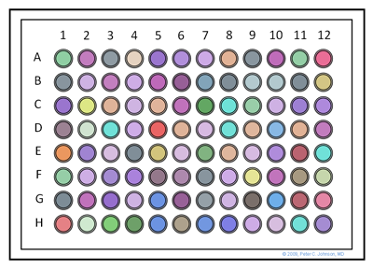
What is effect of LCP1 KO/KD on cytoskeleton structure in cell lines A and B?
Tank 2: LPS-injected guppies
Experimental factor:
LCP1: present/KD/KO
Blocking factors:
Cell line (A/B)
Plate
Position on plate

Slide 26
Outcome
Experimental factors
Nuisance factors (Blocking)
Unexplained variation
Questions
Nuisance factors:
Are the differences observed due to Plate or Position/Plate?
How many plates will you use?
Will there be multiple wells per treatment/cell line?
If so, are these biological replicates or technical replicates?
One plate per cell line, or both cell lines on each plate?

Slide 27
How would you design your experiment?
Control
KO
KD
KO
KD
Control
KD
Control
KO
control
KD
KO
How would you arrange by cell line?

Slide 28
Good or bad design?
Plate 1: A. Plate 2: B
control
KD
KO
A
B
A
Control
KO
KD
KO
KD
Control
KD
Control
KO
B
A
B

Slide 29
Outcome
Experimental factors
Nuisance factors (Blocking)
Unexplained variation
More Questions
Experimental factor:
Does Treatment impact response?
How can we ensure that Treatment is not confounded with the nuisance factors?

Slide 30
Experiment 3:
Differences in synchronous waving patterns in fiddler crabs when females present/absent

Slide 31
Compare mean outcome

Slide 32
Outcome
Experimental factors
Nuisance factors (Blocking)
Unexplained variation
Questions
Nuisance factors:
Are the differences observed due to Cluster?
How many clusters will you use?
Could each cluster receive both treatments?
What are the advantages of assigning both treatments to a cluster?
If so, could the order of treatments matter?

Slide 33
How would you design your experiment?
Cluster 1
Cluster 3
Female
Absent
Present
Cluster 2
Cluster 4
How many runs within each cluster?

Slide 34
Outcome
Experimental factors
Nuisance factors (Blocking)
Unexplained variation
More Questions
Experimental factor:
Does female presence/absence impact response?
How can we ensure that the female effect is not confounded with the nuisance factors?

Slide 35
Observational Study:
Fish community structure on the Ningaloo reef

Slide 36
Outcome
Experimental factors
Nuisance factors (Blocking)
Unexplained variation
Independent experimental variables | Dependent experimental variables
Patch size Patch shape Perimeter: area ratio Edge length Position (i.e. edge vs interior) | Fish community structure • Species Richness • Diversity • Relative abundance • Functional trophic groups present
Experimental unit = patch

Slide 37
Location can confound the effect of patch size on diversity
How can good survey design be utilized?

Slide 38
Other points to consider
Think about how location within the reef can impact on response. Treat location as “block”.
Patches within each location as different as possible with respect to size, shape complexity, edge length etc.
How many locations? How many patches within location?
Position effects are assessed WITHIN each patch
Size effects are assessed BETWEEN patches.

Slide 39
Model-centered thinking:
R, modelling and reproducible research

Slide 40
R: your friendly data analysis tool
Advantages:
Great graphics tools for data visualization and pattern recognition
Easy to model data, interpret and summarise data
Helps with data/project organization
Essential tool for reproducible research/ transparency in research
Disadvantages:

Slide 41
R: your friendly data analysis tool
More Advantages:
Other researchers can follow logic of analysis
Can make code/data available for future researchers
Large community of R users internationally
Use latest analytic techniques (R packages)
Ask questions to experts in field on good analyses
Disadvantages:

Slide 42
R: your friendly data analysis tool
More Advantages:
Code compiles into beautifully formatted document
R coding skills valued inside/outside academia
Disadvantages:
Can be a steep learning curve
Can be hard to get started/ not enough local resources

Slide 43
Example of analysis using R
General workflow
Import data
General data management
Exploratory data analysis
Fit model to data
Check model assumptions, interpret model output
Summarise model using graphics

Slide 44
Example of analysis using R (markdown):
Analysis of root growth.docx

